Slide 1
Chapter 12: File System Implementation

Slide 2
File-System Structure
File structure
  Logical storage unit
  Collection of related information
File system resides on secondary storage (disks)
  Provided user interface to storage, mapping logical to physical
  Provides efficient and convenient access to disk by allowing data to be stored, located retrieved easily
Disk provides in-place rewrite and random access
  I/O transfers performed in blocks of sectors (usually 512 bytes)
File control block – storage structure consisting of information about a file
Device driver controls the physical device
File system organized into layers

Slide 3

Layered File System

Slide 4
File System Layers
Device drivers manage I/O devices at the I/O control layer
  Given commands like “read drive1, cylinder 72, track 2, sector 10, into memory location 1060” outputs low-level hardware specific commands to hardware controller
Basic file system given command like “retrieve block 123” translates to device driver
Also manages memory buffers and caches (allocation, freeing, replacement)
  Buffers hold data in transit
  Caches hold frequently used data
File organization module understands files, logical address, and physical blocks
  Translates logical block # to physical block #
  Manages free space, disk allocation

Slide 5
File System Layers (Cont.)
Logical file system manages metadata information
  Translates file name into file number, file handle, location by maintaining file control blocks (inodes in UNIX)
  Directory management
  Protection
Layering useful for reducing complexity and redundancy, but adds overhead and can decrease performanceTranslates file name into file number, file handle, location by maintaining file control blocks (inodes in UNIX)
  Logical layers can be implemented by any coding method according to OS designer

Slide 6
File System Layers (Cont.)
Many file systems, sometimes many within an operating system
  Each with its own format (CD-ROM is ISO 9660; Unix has UFS, FFS; Windows has FAT, FAT32, NTFS as well as floppy, CD, DVD Blu-ray, Linux has more than 40 types, with extended file system ext2 and ext3 leading; plus distributed file systems, etc.)
  New ones still arriving – ZFS, GoogleFS, Oracle ASM, FUSE

Slide 7
File-System Implementation
We have system calls at the API level, but how do we implement their functions?
  On-disk and in-memory structures
Boot control block contains info needed by system to boot OS from that volume
  Needed if volume contains OS, usually first block of volume
Volume control block (superblock, master file table) contains volume details
  Total # of blocks, # of free blocks, block size, free block pointers or array
Directory structure organizes the files
  Names and inode numbers, master file table

Slide 8

File-System Implementation (Cont.)
Per-file File Control Block (FCB) contains many details about the file
  inode number, permissions, size, dates
  NFTS stores into in master file table using relational DB structures

Slide 9
In-Memory File System Structures
Mount table storing file system mounts, mount points, file system types
The following figure illustrates the necessary file system structures provided by the operating systems
Figure 12-3(a) refers to opening a file
Figure 12-3(b) refers to reading a file
Plus buffers hold data blocks from secondary storage
Open returns a file handle for subsequent use
Data from read eventually copied to specified user process memory address

Slide 10

In-Memory File System Structures

Slide 11
Partitions and Mounting
Partition can be a volume containing a file system (“cooked”) or raw – just a sequence of blocks with no file system
Boot block can point to boot volume or boot loader set of blocks that contain enough code to know how to load the kernel from the file system
  Or a boot management program for multi-os booting
Root partition contains the OS, other partitions can hold other Oses, other file systems, or be raw
  Mounted at boot time
  Other partitions can mount automatically or manually
At mount time, file system consistency checked
  Is all metadata correct?
    If not, fix it, try again
    If yes, add to mount table, allow access

Slide 12
Directory Implementation
Linear list of file names with pointer to the data blocks
  Simple to program
  Time-consuming to execute
    Linear search time
    Could keep ordered alphabetically via linked list or use B+ tree
Hash Table – linear list with hash data structure
  Decreases directory search time
  Collisions – situations where two file names hash to the same location
  Only good if entries are fixed size, or use chained-overflow method

Slide 13
Allocation Methods - Contiguous
An allocation method refers to how disk blocks are allocated for files:
Contiguous allocation – each file occupies set of contiguous blocks
  Best performance in most cases
  Simple – only starting location (block #) and length (number of blocks) are required
  Problems include finding space for file, knowing file size, external fragmentation, need for compaction off-line (downtime) or on-line

Slide 14

Contiguous Allocation
Mapping from logical to physical
Q
LA/512
R
  Block to be accessed = Q + starting address
  Displacement into block = R

Slide 15
Extent-Based Systems
Many newer file systems (i.e., Veritas File System) use a modified contiguous allocation scheme
Extent-based file systems allocate disk blocks in extents
An extent is a contiguous block of disks
  Extents are allocated for file allocation
  A file consists of one or more extents

Slide 16
Allocation Methods - Linked
Linked allocation – each file a linked list of blocks
  File ends at nil pointer
  No external fragmentation
  Each block contains pointer to next block
  No compaction, external fragmentation
  Free space management system called when new block needed
  Improve efficiency by clustering blocks into groups but increases internal fragmentation
  Reliability can be a problem
  Locating a block can take many I/Os and disk seeks

Slide 17
Allocation Methods – Linked (Cont.)
FAT (File Allocation Table) variation
  Beginning of volume has table, indexed by block number
  Much like a linked list, but faster on disk and cacheable
  New block allocation simple

Slide 18

Linked Allocation

Slide 19

File-Allocation Table

Slide 20
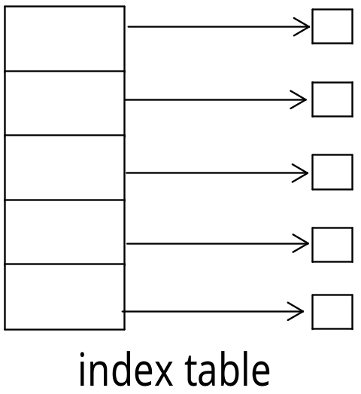
Allocation Methods - Indexed
Indexed allocation
  Each file has its own index block(s) of pointers to its data blocks
Logical view

Slide 21

Example of Indexed Allocation

Slide 22

Linked Free Space List on Disk
Linked list (free list)
  Cannot get contiguous space easily
  No waste of space
  No need to traverse the entire list (if # free blocks recorded)

Slide 23
Free-Space Management (Cont.)
Grouping
  Modify linked list to store address of next n-1 free blocks in first free block, plus a pointer to next block that contains free-block-pointers (like this one)
Counting
  Because space is frequently contiguously used and freed, with contiguous-allocation allocation, extents, or clustering
    Keep address of first free block and count of following free blocks
    Free space list then has entries containing addresses and counts

Slide 24
Free-Space Management (Cont.)
Space Maps
  Used in ZFS
  Consider meta-data I/O on very large file systems
    Full data structures like bit maps couldn’t fit in memory -> thousands of I/Os
  Divides device space into metaslab units and manages metaslabs
    Given volume can contain hundreds of metaslabs
  Each metaslab has associated space map
    Uses counting algorithm
  But records to log file rather than file system
    Log of all block activity, in time order, in counting format
  Metaslab activity -> load space map into memory in balanced-tree structure, indexed by offset
    Replay log into that structure
    Combine contiguous free blocks into single entry

